Slide 1
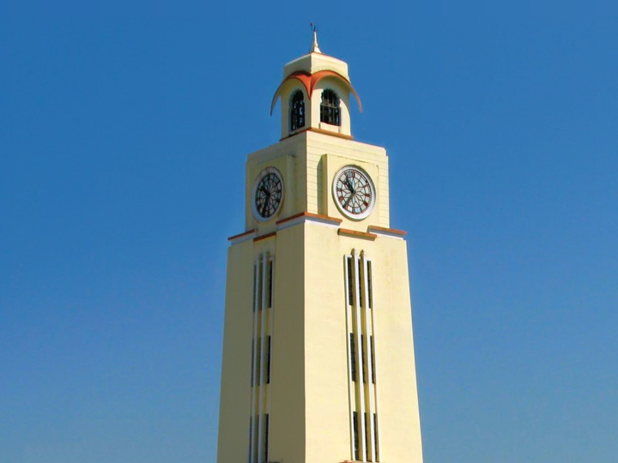
Trouble Ticket System
Dhananjay
Akshay
Kunal

Slide 2
Existing System
Complaints received telephonically
Records not compiled together

Slide 3
Drawbacks and Limitations
No centralised database of all issues tackled
Timeline of issue resolution not maintained
Hard to categorise similar problems and tackle problems at the source
Greater down-time of systems

Slide 4
Objective
To develop a web based client for employees to register complaints, thereby creating a central repository of data regarding problems.

Slide 5
Features
Form for employees to submit a complaint
History of previous complaints and their status made accessible to employees
Plant wise administrators to monitor and resolve complaints
Master level administrators to manage content on the site
Notify appropriate authority via email as soon as a complaint is registered

Slide 6
Advantages
Time and labour saving
Improves accessibility of complaint data
Employees are aware of status of their complaints
Provides a platform for data analysis

Slide 7
Classes Used
Base classes
Database
Log
DatabaseObject
Session
User
Derived Classes
Employee
Plant
Complaint
Problem
Department

Slide 8
Database Tables
Employee
Complaint
Plant
Problem
Department

Slide 9
Scope for Further Development
System can be extended to shop floor
Extend support to mobile apps
Translate to local language to make the system worker-friendly
Challenges include making the system easy to use, bringing it closer to machines in the production line.

